Slide 1

Welcome!
Washington State Chapter
COMMUNITY
ASSOCIATIONS
INSTITUTE
The leading professional organization providing education, resources, and advocacy for community association living.

Slide 2

A Championship Budget
Notes:
Cathy

Slide 3


Who we are
Kevin Ducotey, PCAM, Condominium Management, AAMC. Kevin is the Director of Condominium Management, an Accredited Association Management Company serving Community Associations in the Puget Sound area. Kevin maintains a Bachelor’s in BA – Finance and
a PCAM designation. The PCAM designation is the highest professional recognition available nationwide to managers who specialize in community association management.
Notes:
Cathy

Slide 4

Who we are
Catherine Kuhn, CPA, manages the Bellevue office of Cagianut & Company, CPA, which is devoted exclusively to serving the financial needs of close to 800 Community Associations in Washington. C&C has over 20 years of experience in serving Community Associations.
Notes:
Cathy

Slide 5


Who you are?
Old Act Condominiums (created <1990)
New Act Condominiums (created >1990)
Mixed Use Condominiums
Homeowner’s Associations
Notes:
Cathy
Old Act Condominiums – generally board approves budget and distributes to owners, no ratification meeting
New Act Condominiums/Homeowner Associations/Planned Unit Developments – RCW requires budget ratification meeting

Slide 6
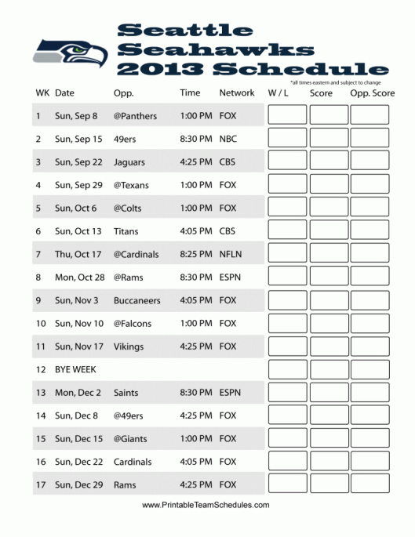
The Schedule Today:
Requirements/Definitions/Roles
  Questions and answers
Budget Development/Pitfalls
  Questions and answers
Financial/Audit Controls
  Questions and answers
Reserve Study – disclosure requirements
  Questions and answers
Notes:
Cathy
ALL fit together
Follow up VERY important Budgeting IS a control
Will emphasize especially the RS in the presentation given new 2012 law

Slide 7

Section 1 –
Requirements/Definitions/Roles

Slide 8
Budget Approval
RCW 64.34.308 – Condominiums
Within thirty days after adoption of any proposed budget for the condominium, the board of directors shall provide a summary of the budget to all the unit owners and shall set a date for a meeting of the unit owners to consider ratification of the budget not less than fourteen nor more than sixty days after mailing of the summary. Unless at that meeting the owners of units to which a majority of the votes in the association are allocated or any larger percentage specified in the declaration reject the budget, the budget is ratified, whether or not a quorum is present. In the event the proposed budget is rejected or the required notice is not given, the periodic budget last ratified by the unit owners shall be continued until such time as the unit owners ratify a subsequent budget proposed by the board of directors.

Slide 9
Budget Approval
RCW 64.38.025 – HOA’s
Within thirty days after adoption by the board of directors of any proposed regular or special budget of the association, the board shall set a date for a meeting of the owners to consider ratification of the budget not less than fourteen nor more than sixty days after mailing of the summary. Unless at that meeting the owners of a majority of the votes in the association are allocated or any larger percentage specified in the governing documents reject the budget, in person or by proxy, the budget is ratified, whether or not a quorum is present. In the event the proposed budget is rejected or the required notice is not given, the periodic budget last ratified by the owners shall be continued until such time as the owners ratify a subsequent budget proposed by the board of directors.

Slide 10
Budget Approval
Horizontal Regime Act
No requirement in the Act.
Refer to the Declaration for requirements.

Slide 11
Mix Use and PUD’s
Mixed of different kind of units – commercial, parking, marina.
What Act do they fall under?
Mix Use - More important to know maintenance responsibilities between association, owner and commercial spaces (for a mix use).
PUD’s – Who is responsible maintain exterior – landscaping, siding, roofing, owner or association.

Slide 12
What is a Budget
CAI’s Definition
A budget is a financial plan for an organization-in this case, a community association. A budget provides an estimate of a community’s income and expenses for a specific period of time.

Slide 13

Assessments vs. “Dues”
There are two types of assessments:
  Periodic assessments
  Special Assessments
“Dues” are optional, as in a Country Club, Health Club, etc.
Membership in a community association is not optional.
Notes:
Cathy
Most people still use the term “Dues” but proper term is “assessments”
JR – I changed monthly to periodic.

Slide 14

Accounting Basics
Just what do “Cash”, “Accrual”, and
“Fund” mean, anyway?
Notes:
Cathy
About this point you’re wondering if you actually signed up for a budget class or accounting class—but they go hand in hand so humor me a bit….

Slide 15

Cash Accounting:
Transaction is recorded when cash is affected, either on the revenue or expense side.
Revenues (assessments) are recorded when they are received, expenses are recorded when they are paid.
Balance Sheet reports cash balances.
Notes:
Cathy
Check book approach
JR – changed effected to affected

Slide 16

Accrual Accounting
:
Transaction is recorded when event occurs, regardless of cash activity.
Revenues (assessments) are recorded when they are charged, whether they are received or not
Expenses are recorded when they are incurred, whether they are paid or not
Balance Sheet reports cash balances, as well as receivables (unpaid assessments) and payables (unpaid obligations).
Notes:
Cathy
Credit Card Approach

Slide 17

Modified Accrual Accounting
Revenues (assessments) are recorded when they are charged, whether they are received or not.
Expenses are recorded when they are paid.
Balance Sheet reports cash balances, receivables (unpaid assessments) and may indicate larger payables (such as major contracts).
Notes:
Cathy
Somewhat common in the industry when monthly expenses are constant Not GAAP

Slide 18

Fund Accounting
Records financial activity by fund (operating fund, construction fund, reserve fund, insurance fund, special assessment fund)
Specific dollars earmarked for specific projects
Notes:
Cathy
Completely separate buckets of money
Industry preferred, but not required

Slide 19

Balance Sheet
Reflects the Association’s financial position as of a given moment in time (usually the last day of the month)
Reflects “Assets” (actual cash, receivables, and pre-paid expenses)
Reflects “Liabilities” (pre-paid assessments, cash deposits, and unpaid expenses)
Shows the year to date and
prior year’s equity
Comparable to a “Net Worth”
statement for personal records.
Notes:
Cathy

Slide 20

Revenue & Expense Statement
Reflects financial activity over a given period of time, usually a month.
Shows different Revenue & Expense categories.
Expenses typically broken down into several categories (utilities & maintenance)
and line items (water, sewer, landscaping,
window washing), reserve Expenses, and
for some formats – reserve transfers and
expenses.
Monthly Budget/Actual/Variance, Y-T-D Budget/Actual/Variance.

Slide 21

Why Do We Care About Accruals & Assets?
The annual budget should be compared to the MONTHLY financial statements.
The MONTHLY financial statements must reflect the budget accurately to be meaningful.
An accurate budget is a great
internal control
An accurate budget is a primary
audit tool by the CPA.
Notes:
Cathy

Slide 22

Who’s Responsible for the Budget?
The Board of Directors is responsible for the development and approval of the budget.
The Board has the ability to delegate its responsibility to develop the budget to a committee, a site manager, or the management company.
Get people involved – the more eyes the better.
Develop a broad base
of experience.
Notes:
Julianne

Slide 23

What is the Manager’s Responsibility?
Managers:
Provide a draft for discussion purposes.
Provide historical data in support of board’s efforts.
Provide future projections in support of their efforts.
Provide industry perspective of
relative costs.
Support the board in the
development of their budget.
Notes:
Julianne

Slide 24

Board Members:
Are the primary drivers of the budget process
Must stay in compliance with the governing documents (timelines, ratification, approvals, etc.)
Review the draft budget, and consider the information contained within the draft budget
Honestly look at the future,
and evaluate projects, expenses,
and reasonable timelines
Notes:
Julianne

Slide 25

Budget Process
Draft Budget
Board review & Adoption
Mailing, Meeting & Ratification
Financial controls
Gather Requirements
Notes:
Julianne

Slide 26

When should we start?
Start early
Be mindful of your declaration requirements
Fiscal year-ends may vary
New act condominiums call for the ratification of the budget, with specific timelines
Count backwards from the date the budget needs to be approved according to declaration requirements (60 days prior to end of the year)
Provide owners with sufficient time to adjust their payments.
Notes:
Julianne
Start early, plan to have your budgets approved before the holidays so the board can take the holiday’s off
Declaration requirements – 30-60 days, plan on holding ratification meetings in late October and early November
For this presentation we will assume a Jan – Dec fiscal year with a Dec 31st year end.
Getting budgets completed in Oct/ Nov enables management to communicate to owners new assessments via statements or coupon books in December prior to January due dates.

Slide 27
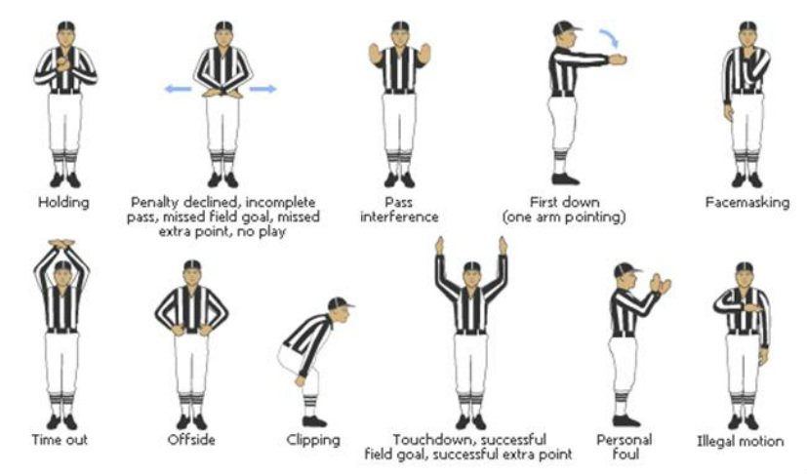
Sources of Budget Requirements
Federal laws and regulations.
State statues, regulations & court decisions.
Local laws and regulations.
The community’s governing documents.
Notes:
Julianne
Ex. Federal – IRS, ADA, Federally established mortgage institutions
Ex. State – RCW HOA Act, Old Act Condo’s & New Act Condo’s, Insurance (WA All in policies)
EX. Local – Fire codes, elevator inspections, property taxes
EX. GD’s – timing, maintenance responsibilities, allocation of expenses

Slide 28
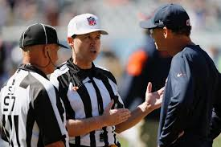
Lender’s Requirements
(FHA, VA, Fannie Mae)
Provides for the funding of replacement reserves for capital expenditures and deferred maintenance amounting to at least 10% of the budget.
Notes:
Julianne
Federally established mortgage institutions may set requirements that your community association will have to meet if owners are to participate in their financing programs.
Fannie Mae, Freddie Mac, FHA or VA

Slide 29

Requirements/Definitions/Roles:
Questions?
Notes:
Julianne

Slide 30

(Section 2) Budget Development
Notes:
Julianne

Slide 31

What is Budgeting?
Budgeting:
Provides an estimate of renvue and expenses.
It’s a system of financial controls.
It’s a philosophy of financial management.
It’s simple in concept, complicated in execution.
It’s worthy of work and attention.
It’s a financial plan.
It represents what is important
to the owners, discretionary
expenses - landscaping

Slide 32

Seahawks
Separation is in the Preparation
www.youtube.com/watch?v=Qlf7sN2p59s

Slide 33

What are the primary drivers of budget development?
The Reserve Study.
Current cash position.
Last year’s budget performance.
Next year’s increases.
Trends from prior year’s budget performance.
Notes:
Julianne
Remember, mistakes, over-budget expenses and un-budgeted spending compound next year.
Cathy is going to cover the cash position, the need to repay shortfalls and have 1-3 mos operating expenses of cash in the OP acct

Slide 34

Budget Tools
General Ledger – year to date.
Accounts Payable Report.
Vendor History.
Invoices.
Balance Sheet.
Income Statement.
Notes:
Julianne

Slide 35

Chart of Accounts
An organized list of name and numbers of all accounts in an organization’s general ledger. The number helps you locate the account. The name describes the purpose of the account.
Determine the chart of accounts for the budget.
The chart of accounts will match the Income Statement.
How detailed should it get?
Notes:
Julianne

Slide 36
Typical Chart of Accounts
Four digit numbers give you flexibility.
1000’s – Assets
2000’s – Liabilities
3000’s – Income
4000’s – Operating – administrative exp.
5000’s – Operating – utilities exp.
6,000 – Operating – Maintenance exp.
7000’s – Reserve Expenses
Notes:
Julianne

Slide 37
Budget Preparation Step 1 – project actual income & expenses
Income – accrual or cash?
Other Income – include other income – late fees, interest, etc.
Include a year’s worth of billing cycles – monthly, semi monthly, quarterly?
Explain significant positive and negative variances
Invoices coded the correct GL.
Reserve expenses must be equal to the reserve transfers
List all reserve expenses.
What is the budget surplus or deficit for the year?
What is an operating expense and reserve expense – list on bottom of budget after “Net Operating Cash”
Notes:
Julianne

Slide 38
Budget Preparation Step 2 – prepare new budget
Income – accrual or cash?
Don’t use other income that is not predictable and guaranteed to balance the budget
Reserve Contribution – use what is recommended in the reserve study as the starting point.
Calculate Operating Expenses – zero base, historical trend, hybrid, contract increases, inflationary increases – utilities.
Discretionary expenses vs. fixed expenses. Most expenses are fixed for the most part.
Reduce expenses if possible– i.e earthquake insurance, save on electric by changing light bulbs.
Solicit bid estimates for planned projects.
Consult with insurance broker for changes in the insurance premium.
Notes:
Julianne

Slide 39
Budget Preparation Step 2 Cont – prepare new budget
Include budget surplus or deficit in new budget. Surplus reduces assessment and deficit inflates the dues.
Include “Bad Debt” – how much?
Review recommended reserve expenses not completed in current year, scheduled in the new year, and possible reserve expenses needed but not planned.
Evaluate Retained Earnings: Accrued Income – Reserve Contribution = Retained Earnings. CAI – recommends 1-3 months of operating expenses.
Evaluate Cash Flow – items that affect cash flow – spending more than income in prior years and receivables.
Notes:
Julianne

Slide 40
Zero-Base Line Items
Assumes $0.00 as a starting point.
The numbers are justified or backed up by a contract amount or assumption.

Slide 41
Historical Trend Items
Uses the prior expenses history of the Association to predict the expenses for the future.
Older Associations have more history, resulting in increasingly accurate budgets.

Slide 42
Would you use zero base, historical, or hybrid to calculate?
Mgmt Fee
Audit
Insurance
Legal
Electric
Water/sewer
Garbage
Irrigation
Building Maintenance
Landscaping
Landscape other
Fire and Safety
Exterior Cleaning.

Slide 43
Budget Preparation Step 2 Cont – prepare new budget?
The most effective approach is to use all three methods to calculate the new numbers.
Budget Notes – how detailed to get? Be able to justify all numbers regardless of method, more details may require a separate sheet, be concise, break down fixed amounts vs. variable.
Assume the reader of the budget knows nothing about the association.

Slide 44
Budget Preparation
Step 2 – prepare new budget?
Breakdown the annual numbers into monthly amounts.
Cuts down on variances (artificial variances).
Takes into account seasonal changes.
Matches budget with reality.

Slide 45
Budget Preparation – final step?
Calculate dues increase to balance the budget.
Is there a cap on the increase amount?
My experience is that increases over time will average approx. 3% a year.
Adopt a policy to increase dues based on a CPI – minimum increase?
It is not a “badge of honor” to keep the dues flat. The “good” board today will become the “bad” board later – 5 years.

Slide 46

Budget Development:
Questions?
Notes:
Julianne

Slide 47
Section 2A – Advanced Budgeting/Financial Health
Bad Debt.
Evaluating Cash Flow.
Prior Year Loss or Surplus.
Contingencies.
Evaluating Retained Earnings.

Slide 48

BAD DEBTS!
Budget for bad debt?
How much – rule of thumb.
Assume the worst, then be pleasantly surprised.
How to handle unused
bad debt – rollover on
balance sheet.
Notes:
Cathy
Show of hands- how many now currently budgeting for BD?

Slide 49

Operating Cash Position
Why is it important?
Determine the Association’s cash position throughout the year.
Operating cash position = short term operating fund assets (cash + receivables) minus short term operating fund liabilities (prepaid assessments + unpaid bills).
What affects cash flow? – spending more money than accrued, delinquencies, bad debt, prepaid dues.
Notes:
Cathy
Ie “Working Capital” for accountants in the audience

Slide 50
Operating Deficit or Surplus:
Shortfall in Year 1 does not go away in Year 2 – budget to repay the short fall or it compounds.
Add line item in new budget – “Prior Year Loss” – inflating the operating expenses. Great way to correct the cash flow position.
Surplus – develop a policy to handle a surplus. Surplus does not happen often – reduce dues or increase the reserve contribution before closing books?
Notes:
Cathy
Need to make sure the next year’s budget covers both the cash short fall repayment, AND, the fact that expenses were over budget so assess need to go up substantially

Slide 51
Operating Deficit or Surplus:
RCW 64.34.356 – Surplus Funds.
Unless otherwise provided in the declaration, any surplus funds of the association remaining after payment of or provision for common expenses and any prepayment of reserves shall, in the discretion of the board of directors, either be paid to the unit owners in proportion to their common expense liability or credited to them to reduce their future common assessment.
Remember – Associations are non-profit.
Notes:
Cathy
Need to make sure the next year’s budget covers both the cash short fall repayment, AND, the fact that expenses were over budget so assess need to go up substantially

Slide 52
Excess Operating Funds? (carryover)
Do NOT decrease/refund assessments (in MOST cases).
Build Up Operating Cash Position (next slide) (Goal is ½ to 3 months of average expenses).
Separate line item in
Budget – “Prior Year Carry Over”
Offset line item is
“Contingencies” (see next topic).
Notes:
Cathy
We VERY rarely see assmts refunded to owners – legal issues – who receives the refund, etc

Slide 53
Contingencies (AKA Murphy’s Law):
How many associations have perfect budgets?
How Much - depends on association!
The more mechanical systems in a building, the more need for a contingency.
Contingency – administrative and maintenance – legal issues, collection, unanticipated / unplanned /unexpected maintenance or repairs.
Notes:
Cathy
Just an estimate so putting in something is better than nothing
Alternatively, build a little cushion into all expense line items

Slide 54
Retained Earnings:
Evaluation Retained Earnings is very important and not done often enough.
Retained Earnings – prior year profit or loss.
Current Year Earnings – profit or loss for current year.
Balance Sheet equation – Assets = Liabilities + Equity.
General Rule – the larger the negative number – the more likely the Association has a problem with cash flow. The larger the positive the number – the more likely the Association has a healthy cash flow.
Notes:
Cathy
Just an estimate so putting in something is better than nothing
Alternatively, build a little cushion into all expense line items

Slide 55
Ten Pitfalls to Avoid:
Using “Other Income” to Balance the Budget.
Not Addressing Budget Surplus or Deficit for the Year.
Not Understanding Budget Variances – why did we over spend?
Not having Enough “Fat” in the Budget to Account for Unexpected Items.
Not Accounting for “Bad Debt” and Not Rolling Over Unused Bad Debt Every Year.
Not keeping Operating Expenses Consistent and Level from Year to Year.
Not Following the Reserve Study and the Recommended Reserve Contribution.
Not Evaluating the “Cash flow” of the Association at Year End.
Not Looking at “Retained Earnings” at Year End.
Not Using the Three Standard Methods to Calculate the Budget Numbers.
Notes:
Cathy
Just an estimate so putting in something is better than nothing
Alternatively, build a little cushion into all expense line items

Slide 56

Advance Budgeting/Financial Health:
Questions?
Notes:
Cathy

Slide 57

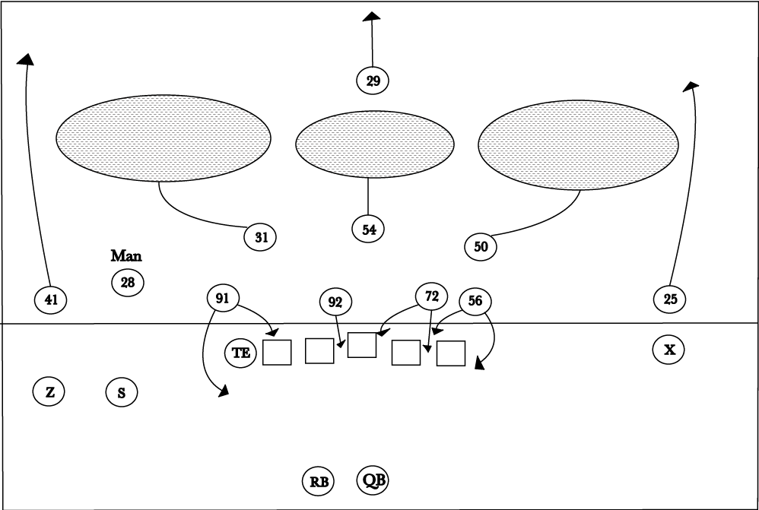
Section 3 – Financial Controls and Audits

Slide 58
Financial Controls and Audits
Don’t change the budget in mid year. Special assessment requires a supplemental budget.
The budget is only an estimate and a tool.
Variances will exist for every item. Important to look at the “Big Picture”.
Read financial statements.
Reconcile bank accounts.
Two board members authorize reserve expenses.

Slide 59
Financial Controls and Audit
Use multiple banking institutions if reserves are over $250K.
Liquidity and Safety more important than return on money.
Borrowing from reserves – not allowed for operating expenses.
Minutes should show approval for all reserve expenses and reserve transfers.

Slide 60

Audits:
What They Do Accomplish
Provides compliance with the Condominium Act, 64.34 for condominiums, 64.38 for HOAs
Provides an opinion on the financial statements as a whole
Provides reasonable assurance that the statements are free of material misstatements
Provide an overview and
understanding of the association’s
financial controls
Provide audit adjustments
(if requested or necessary).

Slide 61
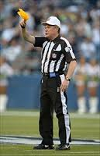
Audits:
What They Don’t Accomplish
Provide bookkeeping for the Association
Provide a reconciliation of bank statements
Provide for discovery of immaterial misstatements
May not detect theft, fraud,
or intentional acts unless
specifically engaged for
that purpose.

Slide 62
Audits:
Do We Have To Have One?
HOA Act 64.38.045 (Homeowner’s Associations):
“…The financial statements of associations with annual assessments of fifty thousand dollars or more shall be audited at least annually by an independent certified public accountant, but the audit may be waived if sixty-seven percent of the votes cast by owners….vote each year to waive the audit.
Notes:
Cathy
$50K Assmts but 67% waiver
Votes CAST by owners, not votes allocated
ASSMTS have to be greater than $50k- what if large unusual income?

Slide 63
Audits:
Do We Have To Have One?
WCA 64.31.372 (New Act Condominiums):
“…At least annually, the association shall prepare…a financial statement of the association in accordance with (GAAP). The financial statements of condominiums consisting of fifty or more units shall be audited at least annually… In the case of a condominium consisting of fewer than fifty units, an annual audit is also required but may be waived annually by unit owners to which sixty percent of the votes are allocated…
Notes:
Cathy
50 or more – req less than 50, possible waiver 60%
Implies ALL owners “votes are allocated”
Think about unusual circumstances b4 automatically waiving
Think about “rotation”

Slide 64

Audits:
Do We Have To Have One?
HPR 64.32.170 (Old Act Condominiums):
“…All books and records shall be kept in accordance with good accounting procedures and be audited at least once a year by an auditor outside of the organization.
Defaults to New Act requirements, UNLESS the Governing Documents for the Old Act Condo require an audit.
Notes:
Cathy
Attorneys have told us this is superseded by the New Act Provisions; HOWEVER, IF the Old Act Declaration requires an audit, then they still need to have an audit, regardless of what New Act says.
Another person in another association is not an “auditor” CPA recommended, but not explicitly stated here

Slide 65

CAI Financial TIPS Brochure
Industry Standards handout

Slide 66

Financial controls & Budget follow-up:
Questions?
Notes:
Cathy

Slide 67
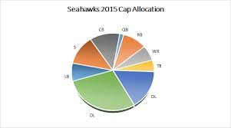
Section 4 - Reserve Study

Slide 68


Requirements Beginning 2012
Disclosures – “As a part of the summary of the budget provided to all owners, the board of directors shall disclose to the owners:”
  Current budgeted reserve contribution rate.
  Recommended contribution from the RS and the funding plan upon which it is based.
  Any additional regular or special assessments scheduled, due date and purpose.
  If current projected reserve balances will be sufficient at the end of each year to meet the association’s obligation for major maintenance, repair or replacement of reserve components during the next 30 years.
Notes:
Julianne
The following information from the reserve study must be provided to all owners as part of the summary of the annual budget:

Slide 69

New requirements as of 2012
  If reserve balances are not projected to be sufficient, what additional assessments may be necessary to ensure sufficient funds.
  Estimated amount recommended in reserves at the end of the current year, projected actual and percent funded.
  Estimated amount recommended in reserves at the end of the next five budget years, projected balance each year.
  If funding plan is implemented, the projected balance for the next five years and % funded each year.
Notes:
Julianne
Wow that seems like a lot of new requirements.
But the requirements are fairly simple if you have a current reserve study and follow the recommended funding plan.
The RS provides all of this information in a couple of pages which can be included in your budget mailing.
The new requirements are all about proper disclosure to the owners so there are no big surprises.

Slide 70

Annual Disclosure Requirements
Contact your reserve study provider – they will prepare the disclosure document.

Slide 71
Reserve Study Comments?
Frequently asked Question– How much to contribute?????
The study establishes a savings plan to fund the rate of depreciation.
What is a reserve Expense and what is an operating expenses?
Reserve study providers offer a 3 year contract that covers the study with site visit and the two consecutive annual updates. Spreads the cost out evenly.

Slide 72
Reserve Study Comments?
Recent changes require that window, siding, and plumbing are included in the component list. Biggest impact is the windows.
Disclosures – annual study updates, summary disclosure with operating budget.
Maintenance Responsibilities – know who is responsible to maintain every component, create a policy.

Slide 74
Some Statistics
Notes:
Julianne
Sample of AR funding plan

Slide 75
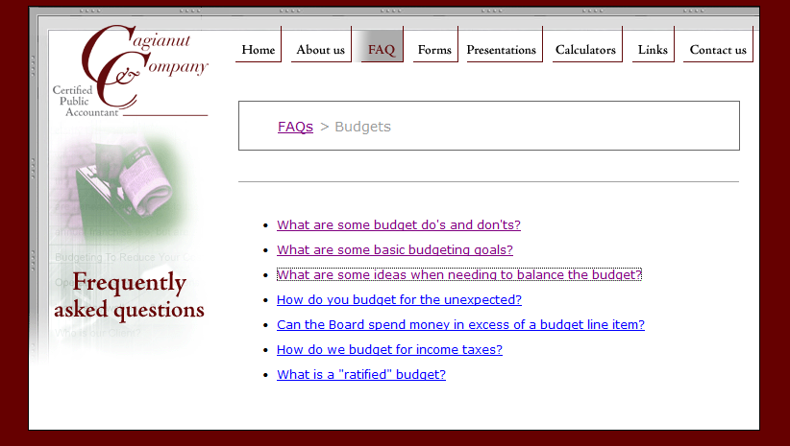
Cagianut & Company Budget FAQ’s
Notes:
Cathy

Slide 76


PPT Presentation:
www.hoacpa.com
Condominium Management
Kevin Ducotey
425 562-1200 x 126 kducotey@condohoa.net www.condominium-management.com

Slide 77

Questions ?
Thank you!
Cathy Kuhn – Cathy@hoacpa.com
Kevin Ducotey – kducotey@condohoa.net

Slide 78
CAI and the
Washington State Chapter of CAI
Working Together to Serve You
Locally and Nationally
WSCAI.org
425-778-6378
CAIonline.org
1-888-224-4321

